Slide 1
Improved Hot Water Code Calculation
Final Report
FBC Energy and Mechanical Technical Advisory Committees Concurrent Teleconference Meeting
June 20, 2017

Slide 2
Research Purpose and Goal
Characterize hot water waste sources
Characterize implications of climatic differences on hot water use
Characterize energy impacts of hot water recirculation systems and controls with respect to energy consumption in Florida homes
Recommend Florida-specific methods to employ in the Florida Energy Code for residential hot water use and energy consumption calculations

Slide 3
Expected Outcome and Impact
on the Code
Project report will include recommendations suitable for consideration by the FBC in determining the most appropriate Florida-specific methods, procedure and calculation for determining the energy use effectiveness of domestic hot water systems for the residential FEC.

Slide 4
Research Approach
Four project tasks:
  Task 1: A “hot water” and “energy” search terms literature review
  Task 2: Development of hot water energy use calculation procedures by month, climate, circulation design and hot water system type

Slide 5
Research Approach
Four project tasks (cont.):
  Task 3: Compare hot water energy use for 2, 3, and 4-bedroom homes in Miami, Orlando and Jacksonville calculated with new procedures vs. use determined by old (current) code calculation
  Task 4: Using EnergyGauge® USA simulations, determine and document the difference in overall energy code performance scores (total e-Ratios) for two sample homes.

Slide 6
Task 1: Literature Review
Searched on "hot water distribution" and "energy" terms in NREL, LBNL, ASHRAE and DOE BA databases + general search + other
40+ pertinent documents identified
Review showed anticipated levels of waste and use factors– including plumbing design, insulation, climate (time of year and location) and occupant demographics
Final report includes expanded summary discussion

Slide 7
Task 1: Literature Review
Principal factors not adequately considered by standard building energy code hot water calculations:
  Variation in service water temperatures by climate location
  Hot water system design significantly impacts both the quantity of hot water used and energy consumption
  Hot water circulation pumps can reduce hot water use but also dramatically increase energy use

Slide 8
Task 2: Calculation Procedure Development
Starting point was industry vetted ANSI/RESNET 301-2014 Addendum A-2015
Florida-specific adaptations include:
  Calculation by month
  Florida climate adjustment (T_{mains} and F_{mix})

Slide 9
Task 2: Calculation Procedure Development
Starting point was industry vetted ANSI/RESNET 301-2014 Addendum A-2015
Florida-specific adaptations include:
  Calculation by month
  Florida climate adjustment (T_{mains} and F_{mix})
Solar and HRUs addressed “upstream”

Slide 10
Task 2: Calculation Procedure Development (cont.)
Additional DHW characteristics accounted for by the new calculation procedure:
Recirculation DHW distribution systems
Pipe insulation
Fixture flow efficiency (standard or “low-flow”)
Pipe length
Drain water heat recovery (DWHR).

Slide 11
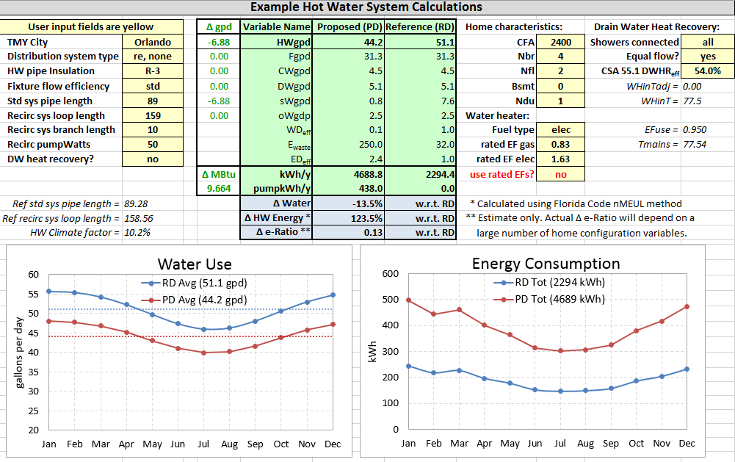
Interactive DHW Energy Consumption Calculator

Slide 12
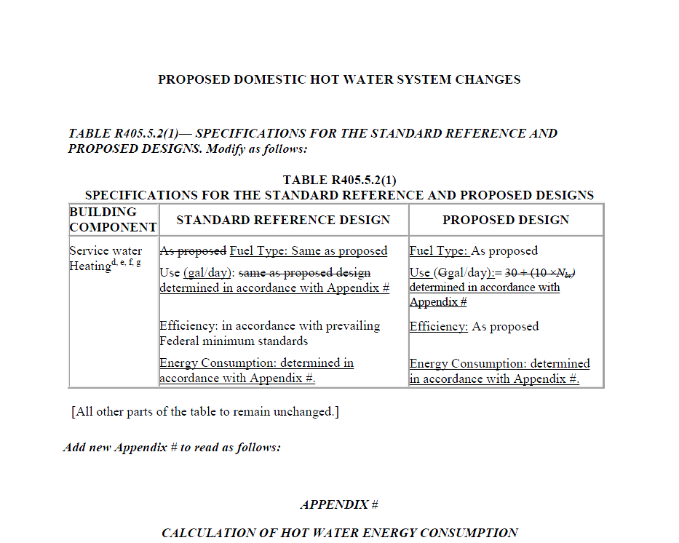
Draft Proposed Code Change Language

Slide 13
Task 3: Energy Use Comparison
DHW energy consumption calculator used to compare estimated annual hot water energy use of sample houses using the old (current) calculation procedure with the energy use resulting from using the new calculation procedure

Slide 14
Task 3: Energy Use Comparison (cont.)
Comparison used 2, 3 and 4 bedroom, 2,000 sq. ft., one-story sample houses with baseline efficiency electric water heaters in three Florida cities: Miami, Orlando and Jacksonville.

Slide 15
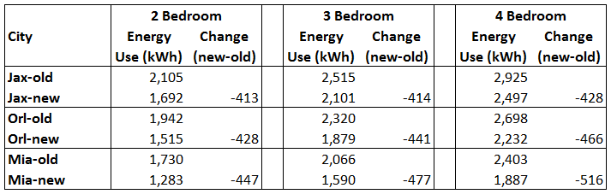
Task 3: Energy Use Comparison (cont.)

Slide 16
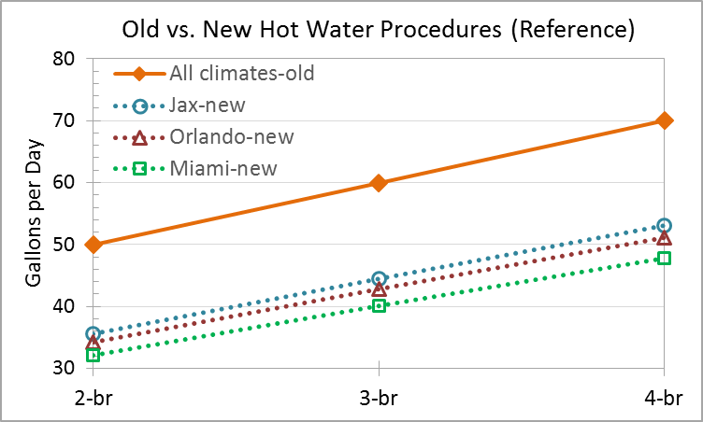
Task 3: Energy Use Comparison (cont.)

Slide 17
Task 4: Energy Code Performance Score Comparison
EnergyGauge USA used to compare overall energy code performance scores (e-Ratios) using old (current) code hot water calculation procedure vs. new procedure
Comparison started with all-electric “near-code” sample house with standard hot water distribution system modeled in Miami, Orlando and Jacksonville

Slide 18
Task 4: Energy Code Performance Score Comparison (cont.)
Near-code house plus eight hot water distribution design and equipment efficiency variation cases:
  1) Near-code sample house with standard hot water distribution system
  2) Recirculation system with manual control and R-3 pipe insulation (manually controlled on/off, 178.89 ft. loop length, 10 ft. branch length and 50 Watt pump)
  3) Drain water heat recovery (DWHR); no other changes from Case #1
  4) Recirculation with manual control and 50% pipe length and pump power, and R-3 pipe insulation
  5) Same as Case #4 plus DWHR and low-flow fixtures
  6) Heat pump water heater (HPWH) with EF = 2.5; no other changes from Case #1
  7) Tankless natural gas water heater with EF = 0.83; no other changes from Case #1
  8) Recirculation with temperature control (instead of manual control) and R-3 pipe insulation
  9) Standard distribution system with 50% pipe length and R-3 pipe insulation.

Slide 19
Task 4: Energy Code Performance Score Comparison (cont.)
Combined (cooling, heating and water heating) results for 2, 3 and 4 bedroom homes in the three cities are shown in report Table 4:
  e-Ratio differences between old (current) and new procedure for distribution design and conservation measures ranged from -6.55 to +11.42
  e-Ratio differences between old (current) and new procedure for EF = 0.83 tankless gas WH and EF = 2.5 HPWH ranged from +0.45 to +1.98 (reflects smaller overall e-Ratio impact from hot water in new procedure)

Slide 20
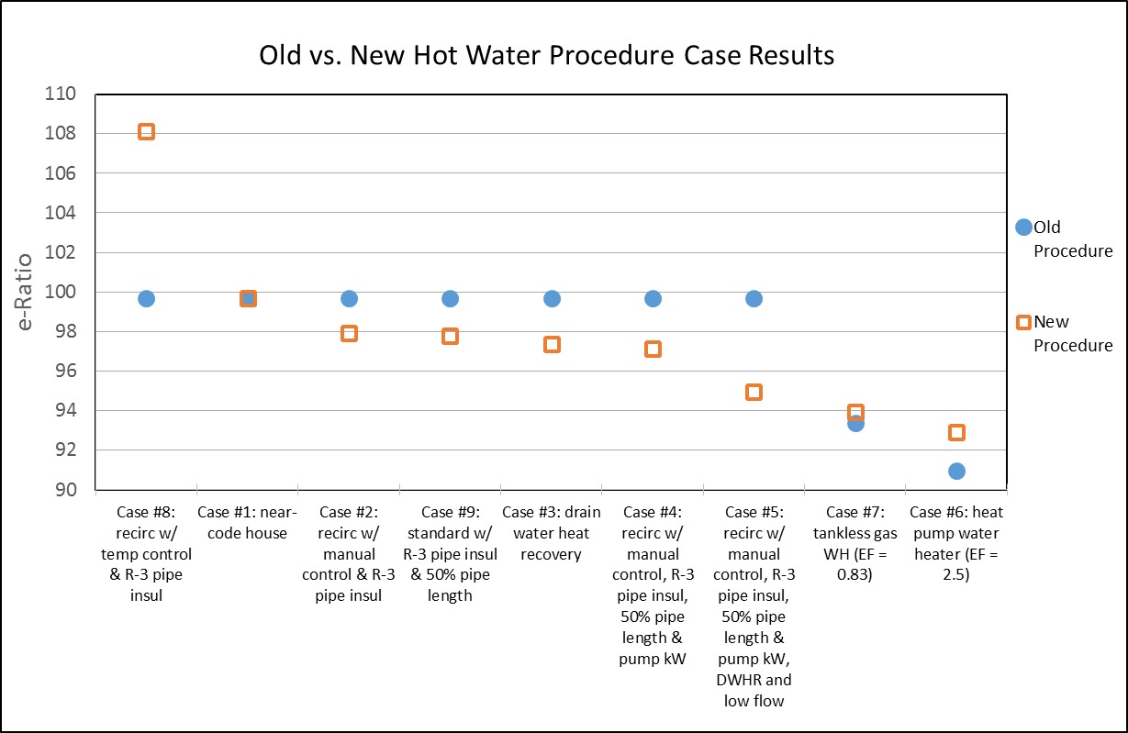
Task 4: Energy Code Performance Score Comparison (cont.)

Slide 21
Controls for Recirculation Systems
Mandatory circulation system control requirements in 6th Edition Section R403.5.1.1 are not explicit
Section R403.5.2 provides requirements for demand recirculation system control based on “receiving a signal from the action of a user of a fixture or appliance” and limiting the temperature of water entering cold piping
Refer to Section R403.5.2 in Section R403.5.1.1.

Slide 22
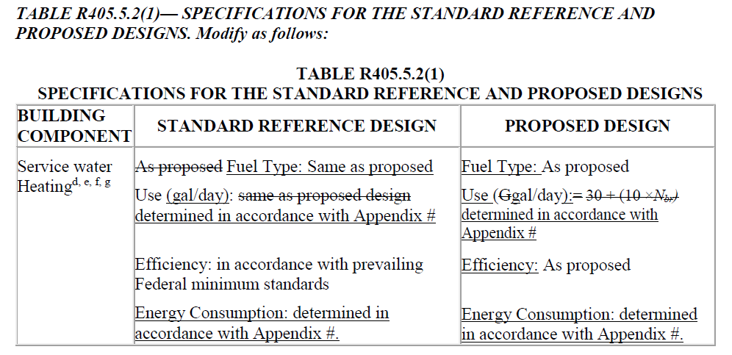
Recommendations
Since the hot water factors discussed can significantly affect residential energy use and are accounted for in the new Florida calculation procedure, we recommend adoption of the corresponding draft DHW code change language.

Slide 23
Recommendations
Since the mandatory circulation system control requirements in Section R403.5.1.1 are not explicit, we recommend referring to Section R403.5.2 in Section R403.5.1.1 to insure that proper pump controls are required by the code.

